Slide 1
Email Management System
Name: Nikita Suresh Mehtre
Enrollment Number: EBEON1121490384
Batch: 2021-6364
Guided By: Akanksha Pandey

Slide 2
Introduction
Email is the message or some important information that we send to a person or organisation. The email management is an application that will allow the organisation in managing high volume of emails that they receive.
The user can login with the username and password after registration process. Once logged in user will be able to view any updates that are available. User can also check remainders present in the inbox.

Slide 3
System Requirement:
Software requirements:
Operating System: Windows 10 (20H2)
IDE : Eclipse 2021-09 (4.21.0)
JRE : jdk-17_windows-x64_bin
Languages Used : JAVA, HTML, CSS, MySQL
Software's Used : Postman, Spring Initializer, phpMyAdmin
Hardware requirements:
Processor : 1th Gen Intel(R) Core(TM) i5-11400
Installed RAM : 16.0 GB
System Type : 64-bit operating system, x64-based processor

Slide 4
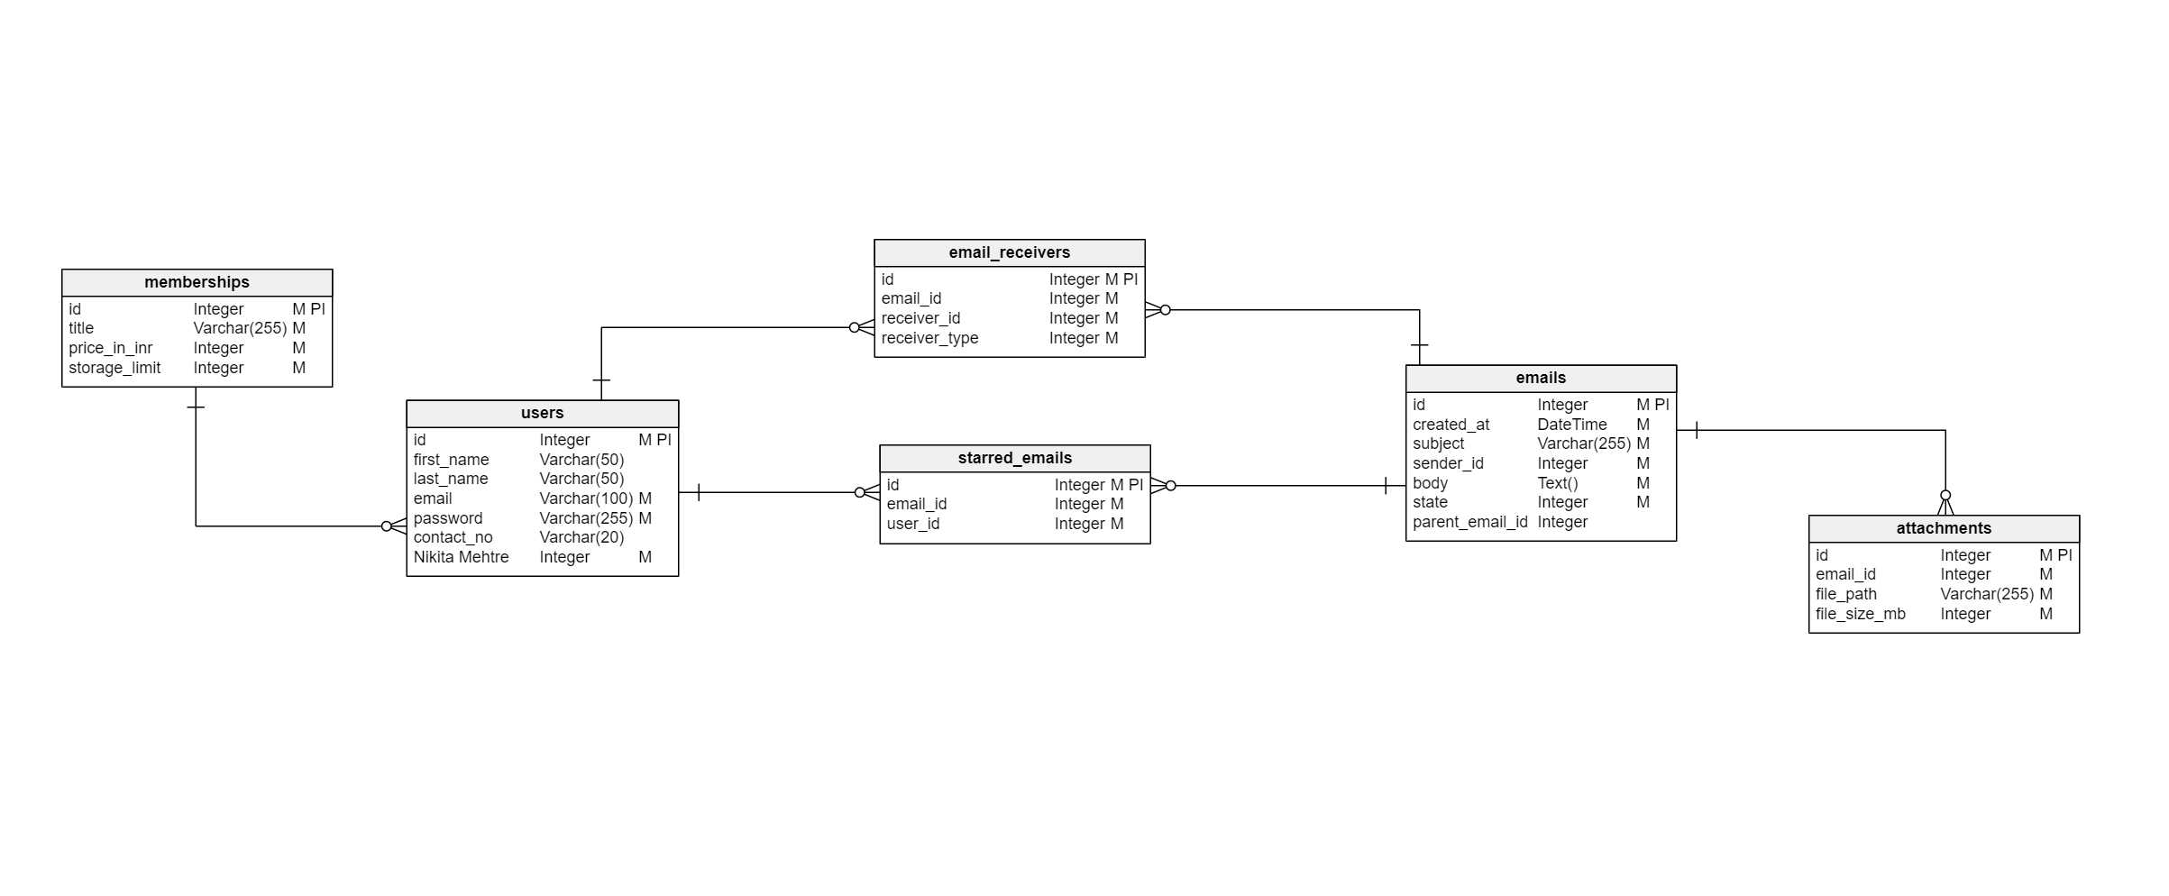
Entity Relationship Diagram:
Fig-ER for Email Management System

Slide 5
Fig-Spring Initializr is a web-based tool provides API to generate JVM based projects, inspect the metadata used to generate projects

Slide 6
Fig- Project Object Model (pom.xml) configuration information for maven dependencies, source directory, plugin etc.

Slide 7
Application Properties:
Fig- application.properties file required to execute maven project

Slide 8
Annotations Used in Entity:
@Data : Lombok data annotation generates getters for all fields.
@Entity annotation defines that a class can be mapped to a table.
@Table annotation allows you to specify the details of the table that will be used to persist the entity in the database.
@Generated value : Provides for the specification of generation strategies for the values of primary keys.
@Temporal: Used to insert date, time in database table.
@Enumerated : Specifies that a persistent property or field should be persisted as a enumerated type.
@JsonBackReference : A backreference that omits during the serialization process.

Slide 9
Annotations Used in Controller:
@GetMapping: Annotation for mapping HTTP GET requests onto specific handler methods.
@PutMapping: Annotation for mapping HTTP PUT requests onto specific handler methods.
@PatchMapping: PATCH is used when you want to apply a partial update to the resource and @PatchMapping annotation for mapping HTTP PATCH requests onto specific handler methods.
@DeleteMapping: Annotation maps HTTP DELETE requests onto specific handler methods.

Slide 10
Fig- Demo emails in phpmyadmin tool for MySQL database storage

Slide 11
MySQL Database Using phpMyAdmin:
PhpMyAdmin is an open-source, web-based database administrator interface used to interact with database on a server.
Database management is very easy using Structured Query Language(MySQL). There are different clauses are used for data manipulation.
From phpMyAdmin we can navigate to the SQL tab on either the database or the table and build the queries we want from there.

Slide 12
Fig- Users table in Email Management System Project

Slide 13
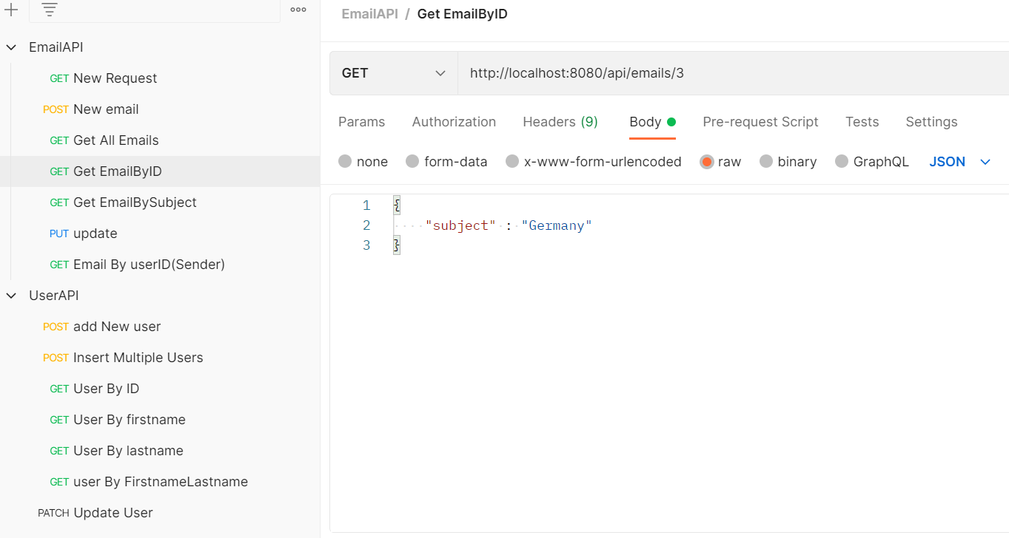
Fig- Postman an application used for API testing. It is an HTTP client that tests HTTP requests, utilizing GUI

Slide 14
Fig.-Index page and features provided

Slide 15
Fig- To operate this system user need to register first

Slide 16
Fig.-Login page for user to operate system

Slide 17
Fig.- Final output for user to view all emails

Slide 18
Fig.- User can send an email to multiple users at once

Slide 19
Advantages:
E-mails turn to be cheaper alternative to telephone conversation.
Eliminates time spent in establishing telephone calls.
Email saves environment as it is a paperless communication.
Emails are more convenient than any other mode of communication.

Slide 20
References:
https://www.postman.com/downloads/
https://start.spring.io/
https://my.vertabelo.com/logical/model/VeuYCyhmr665UmmTWCIENaSlxSVSe0nm
https://www.phpmyadmin.net/
https://www.sublimetext.com/download
https://www.w3schools.com/html/html_images.asp
https://www.w3schools.com/html/html_classes.asp

Slide 21
THANK YOU!

